Slide 1
(ISC)² Cybersecurity Workforce Study 2021
Dr. John ILIADIS
CMgr MCMI, CISSP-ISSMP, CRISC
(ISC)² Hellenic Chapter, Board Member

Slide 2
(ISC)² = International Information Systems Security Certification Consortium, established in 1989
Non-profit consortium of information security industry leaders
Supports security professionals throughout their careers
Global Standard for information security: (ISC)² CBK®
Over 160,000 certified professionals; over 170 countries
270 members in Greece, established in 2015

Slide 3

EDUCATE & CERTIFY the world’s security professionals
Notes:
so we educate and certify professionals to help them create a more safe and secure cyber world

Slide 4

Professional Development Institute
Self-paced online learning
Immersive, Express and Lab courses
Interactive, engaging and timely
Modular content combined with interactive activities
  Written content, videos, interactive
  labs, case studies, assessments and more
www.isc2.org/development

Slide 5
High growth – Number of professionals
 | 2019 | 2020 | 2021 | %2020-2021
Germany | 133.000 | 175.159 | 464.782 | ↑ 165%
Singapore | 43.000 | 57.765 | 92.744 | ↑ 61%
Europe | 543.000 | 830.187 | 1.086.146 | ↑ 31%
United States | 804.700 | 879.157 | 1.142.462 | ↑ 30%
GLOBAL | 2.802.700 | 3.484.971 | 4.192.255 | ↑ 20%

Slide 6

2.72 MILLION
Workforce Gap
Source: (ISC)² Cybersecurity Workforce Study, 2021
Notes:
Most organizations struggle to find qualified people to secure their critical assets.
Simply put, employers are struggling to hire and retain qualified talent for several reasons, including the simple lack of experienced professionals on the market and the high demand for talent.

Slide 7
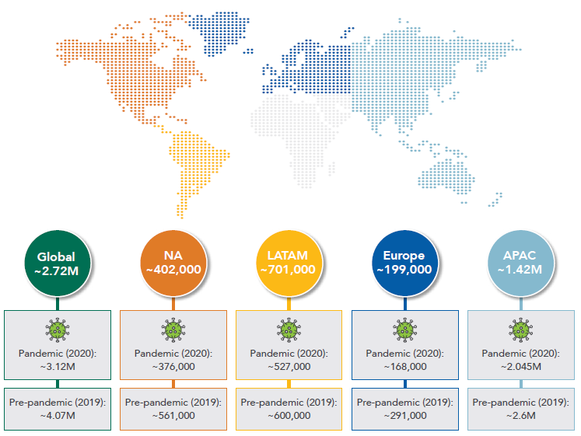
Gap in professionals 2019-2021

Slide 8
The Study
…survey data from 4.753 cybersecurity professionals throughout
North America,
Europe,
Latin America (LATAM) and
Asia-Pacific (APAC)

Slide 9
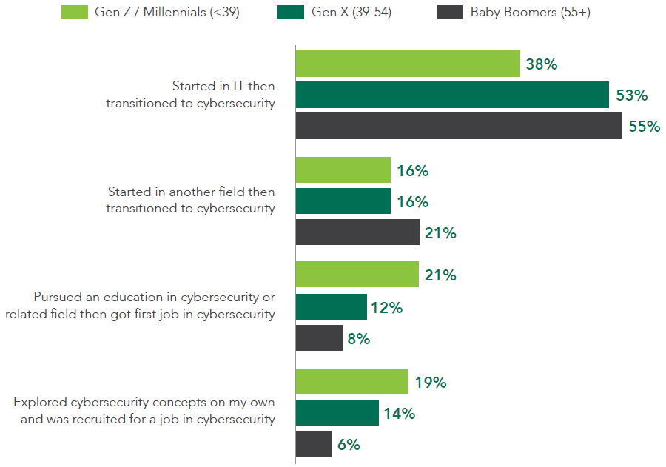
Pathway to Cybersecurity

Slide 10
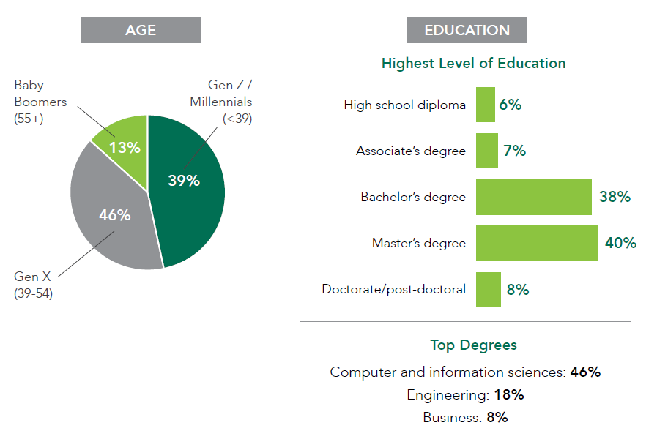
Cybersecurity Workforce Snapshot

Slide 11
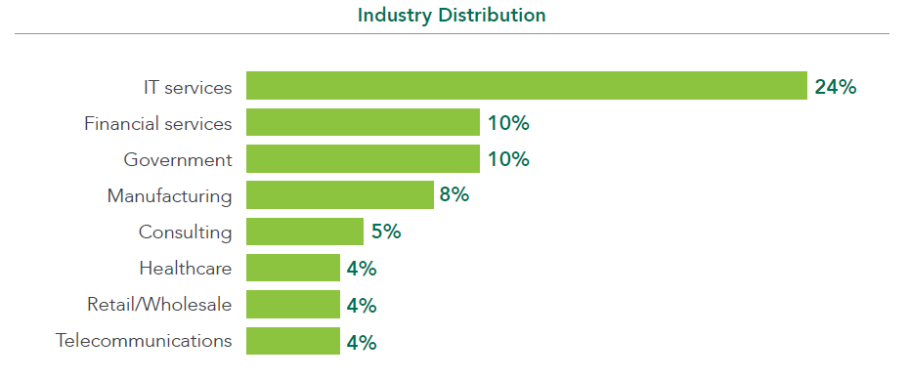
Cybersecurity Workforce Snapshot
Most (ISC)² certifications are listed on the U.S. DoD 8140.01/8570.01

Slide 12
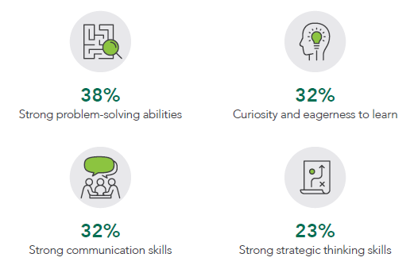
Qualifications in need
equally important as cybersecurity certifications (32%)

Slide 13
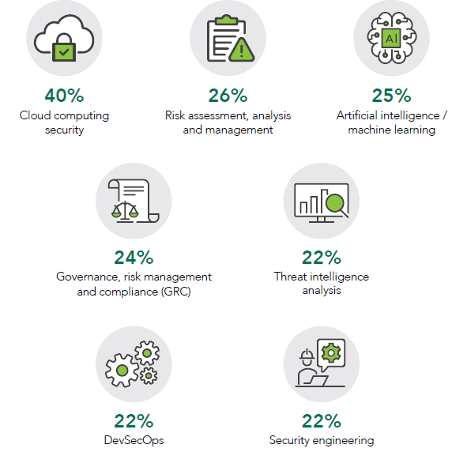
Professional Development Areas Pursued
CCSP coming soon to a theater near you

Slide 14
Some takeaways
Understand Your Gap; which roles do you need to fill?
Rethink How You Hire; expand your candidates’ pool by evaluating prospects for non-technical qualifications
Put People Before Technology; organizations cannot spend their way out of the gap. They need to invest in people and build teams for long-term success
Embrace Remote Work; cybersecurity professionals want to continue working remotely. Also, remote work casts a much wider recruiting net.

Slide 15
Thank you ! j.iliadis {at} isc2-chapter.gr

